Slide 1

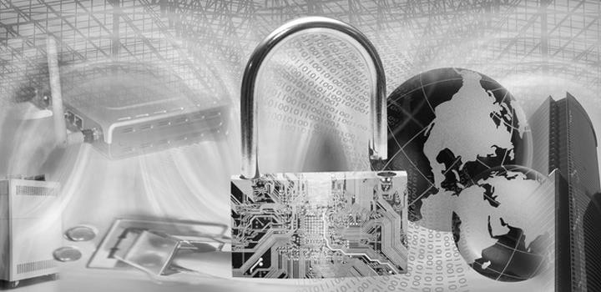
ITEC614 Introduction to Cyber Security
Dr. Farshid Keivanian
Lecturer, Information Technology, PFBS

Slide 2
Protecting a CS Domain
Lecture 8

Slide 3
Previous Lecture…
Have studied…
Access control
Access control elements
MAC, DAC & RBAC
BLP model
Biba model
Chinese wall model

Slide 4
Today’s Objectives
Defending Systems and Devices
Describe how cybersecurity domains are used within the CIA triad.
Explain how technologies, processes and procedures protect systems.
Server Hardening
Explain how to protect servers on a network.
Network Hardening
Explain how to implement security measures to protect network
devices.
Physical Security
Explain how physical security measures are implemented to protect network equipment.

Slide 5
References
This lecture is based on
CISCO Cybersecurity Essentials v1.0
Chapter 7: Protecting a CS Domain
CISCO material are used with permission.

Slide 6
Operating System Security (Host Hardening)
Think of your computer like a house. If the windows and doors are always open (default settings), intruders can easily walk in. Hardening is like locking the doors, closing windows, and installing security cameras.
Remove unnecessary programs and services (like locking unused doors).
Apply updates and patches (like fixing broken locks).
Example: Disabling file-sharing services on a uni lab PC if not needed.

Slide 7
Operating System Security (Host Hardening)
Discussion Question:
Why is it important to remove unused services from a public PC?
Reduces attack surface; fewer vulnerabilities for attackers to exploit.

Slide 8
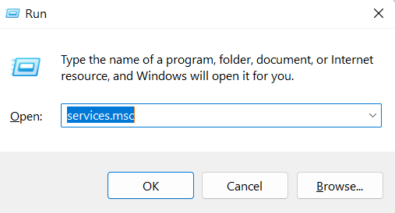
Operating System Security (Host Hardening)
Hands-on Activity:
Use Windows Settings to disable unneeded services.
Open Services in Windows
Press Windows Key + R to open the Run dialog.
Type services.msc and press Enter.

Slide 9
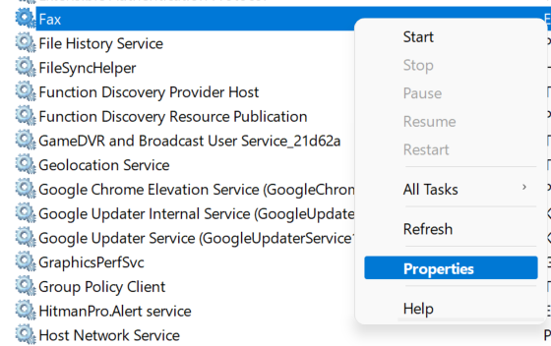
Operating System Security (Host Hardening)
The Services window will open, showing a list of all Windows services.
Right-click any service you want to disable, then choose Properties, and set Startup type to Disabled.
(Tip: Be careful! Disable only non-critical services, like "Fax" if you don’t use faxing.)

Slide 10
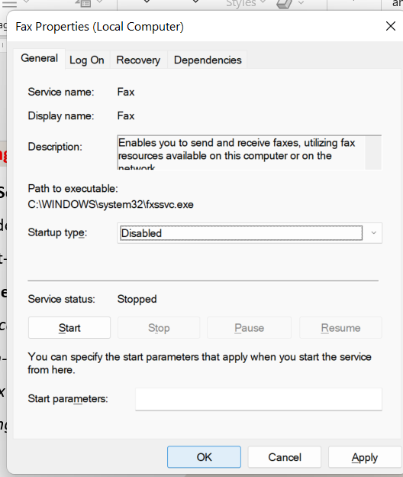
Operating System Security (Host Hardening)
The Services window will open, showing a list of all Windows services.
Right-click any service you want to disable, then choose Properties, and set Startup type to Disabled.
(Tip: Be careful! Disable only non-critical services, like "Fax" if you don’t use faxing.)

Slide 11
Operating System Security (Host Hardening)
Security Benefit:
Minimizes attack surface: Fax is an outdated service, and if not used, keeping it enabled can be a backdoor for attackers.
Reduces vulnerabilities: Disabling unused services helps prevent exploitation of legacy protocols.

Slide 12
Operating System Security (Host Hardening)
Performance Benefit:
Frees up system resources: Disabled services no longer consume RAM or CPU cycles in the background.
Faster startup times: The fewer services Windows has to launch at boot, the quicker your system starts.

Slide 13
Operating System Security (Host Hardening)
System Hardening Practice:
It’s a real-world technique in cybersecurity to “harden” a system by removing or disabling anything unnecessary.
Skill Area | What We Explored
Windows Security | How to locate and manage system services safely.
Threat Reduction | That fewer active services = fewer possible attack paths.
System Optimization | Better performance and system control.
Cyber Hygiene | Habit of checking and maintaining secure configurations.

Slide 14
Operating System Security (Host Hardening)
Problem-Solving:
You notice outdated software on a shared lab computer. What do you do?
Report it or apply patches if authorized.

Slide 15
Antimalware
Malware is like digital germs. Antivirus is your hand sanitiser. It helps block, detect, and remove harmful software like keyloggers, spyware, and ransomware.
Example: Use built-in Microsoft Defender or install AVG/Avast on your laptop.

Slide 16
Antimalware
Role-Playing Question:
You’re IT support. A user opens a suspicious email attachment. What do you do?
Run a malware scan, isolate the system, and investigate further.

Slide 17
Patch Management
Patches are software band-aids. They fix security holes just like fixing broken locks on doors.
Example: Installing the latest Windows updates on ACU lab machines.

Slide 18
Patch Management
Discussion:
Why is delaying updates risky?
Hackers exploit unpatched systems

Slide 19
Host-based Firewalls & HIDS
Firewalls: Like security guards that check incoming/outgoing traffic.
HIDS (Host Intrusion Detection): Like a CCTV system, alerts if something suspicious happens on the computer.

Slide 20
Host-based Firewalls & HIDS
Problem-Solving:
You see multiple failed login attempts in your HIDS. What’s your next step?
Investigate source IP, block access, report incident.

Slide 21
VPNs (Secure Communication)
A VPN is like a secure tunnel between your computer and the university – your data stays private.
Example: Using University VPN while working off-campus.

Slide 22
VPNs (Secure Communication)
Question:
Why might a university staff use a VPN when using public Wi-Fi?
To protect their credentials from being stolen

Slide 23
Wireless Security (WEP/WPA/WPA2)
WEP vs WPA2:
WEP is like using a zipper lock on your luggage—easy to break into.
WPA2 is like a solid TSA-approved lock—tougher and more reliable. In Australia, most public Wi-Fi hotspots (e.g., at Westfield or cafes) now use WPA2 for better protection.

Slide 24
Wireless Security (WEP/WPA/WPA2)
Mutual Authentication:
Imagine logging into your student portal and it also checks that it’s really you and you're connecting to the official ACU server, not a fake one.
Like a two-way ID check — “I trust you if you trust me.”

Slide 25
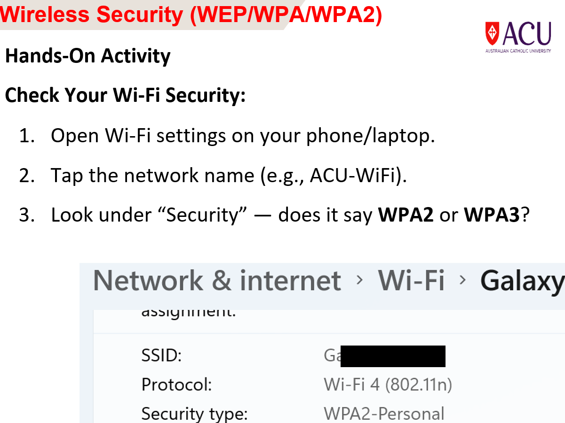

Slide 26
Wireless Security (WEP/WPA/WPA2)
Role-Playing Debate:
One team argues WEP is still usable, the other argues it must be upgraded. Who wins and why?
WPA2 team wins – WEP is easily cracked.

Slide 27
File Access, Encryption, Backups
Access control: Only certain people can open files (like locked drawers).
Encryption: Data turned into unreadable format unless you have the key.
Backup: Copying data to a cloud (Plan B in case of failure).

Slide 28
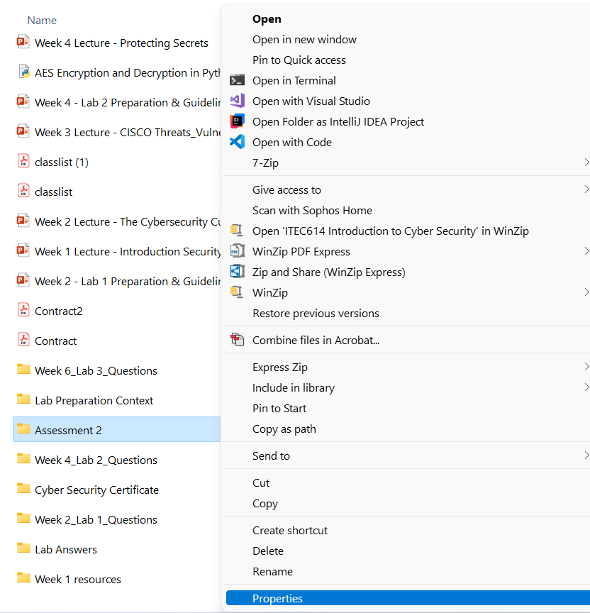
File Access, Encryption, Backups
Hands-on Activity:
Encrypt a folder in Windows
Encrypt a Folder
Right-click the folder we want to encrypt.
Click Properties → then click the Advanced... button.

Slide 29
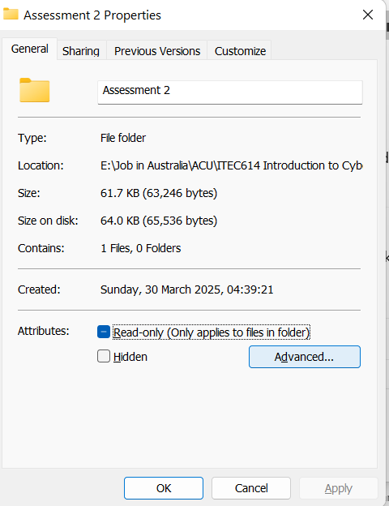
File Access, Encryption, Backups
Encrypt a Folder
Right-click the folder we want to encrypt.
Click Properties → then click the Advanced... button.

Slide 30
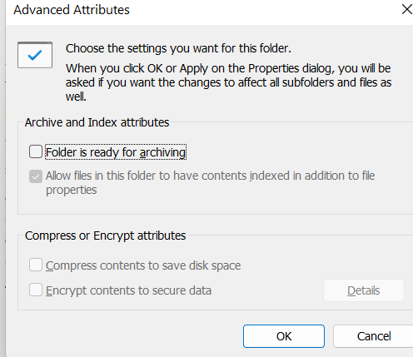
File Access, Encryption, Backups
Tick Encrypt contents to secure data (if available) → OK → Apply.
Choose whether to apply to just the folder or to all subfolders and files.

Slide 31
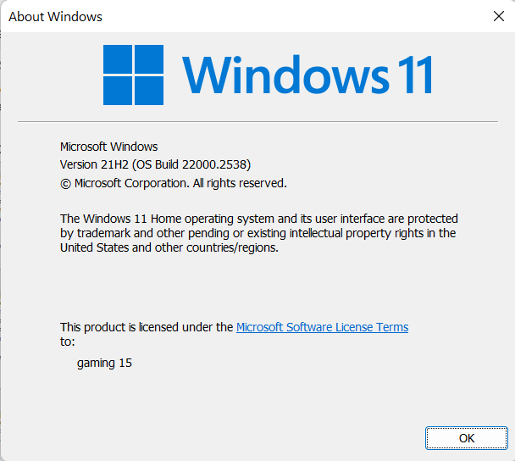
File Access, Encryption, Backups
Press Windows + R, type winver, and press Enter.
You may be using Windows 11 Home; file encryption will not be supported. You would need Windows 11 Pro or higher to use this feature.

Slide 32
File Access, Encryption, Backups
The folder and its contents become encrypted using EFS (Encrypting File System).
Only the current Windows user account can access the files — even if someone copies the folder to another machine, they can't open the files.
A certificate is automatically created and stored in the user’s profile. This allows decryption.

Slide 33
File Access, Encryption, Backups
They’ll be prompted to back up their encryption certificate (important for recovery if Windows is reinstalled or the account is deleted).
We don’t need to be connected to a network or domain — it works on personal devices too.

Slide 34
File Access, Encryption, Backups
When should we use this?
To secure personal or sensitive files (e.g., finance, research, reports) without full disk encryption.
When sharing the same PC with others, but needing user-specific confidentiality.
To demonstrate real-world data confidentiality practices in cybersecurity lessons.

Slide 35
File Access, Encryption, Backups
Important Note
If we lose our encryption certificate, we could lose access permanently.
We need to Back up the certificate when prompted (usually saved as a .pfx file with a password).

Slide 36
File Access, Encryption, Backups
Problem-Solving:
You lose your laptop. What ensures your data isn’t stolen?
Encrypted files and strong passwords.

Slide 37
Content Control & Deep Freeze
Control Software:
Think of it like a library filter — just like how public libraries block certain books or media from public computers, content control software blocks unsafe or inappropriate websites (e.g., scams, adult content).
Example: At Australian schools and libraries, tools like SafeDNS are used to keep students safe from risky sites while studying online.

Slide 38
Content Control & Deep Freeze
Deep Freeze:
Imagine your laptop is like a whiteboard in a classroom — you can write anything during class, but every night a cleaner comes and wipes it back to a clean slate.
Used in places like ACU computer labs, this ensures any mistakes, viruses, or accidental changes disappear after a reboot.

Slide 39
Content Control & Deep Freeze
Research Discussion – Should Public Libraries Use Deep Freeze?
What are the benefits of using Deep Freeze in public library computers?
What problems could it cause for library users or staff?
Would you recommend it for your local council library? Why or why not?

Slide 40
Content Control & Deep Freeze
Purpose: Helps students apply their understanding of Deep Freeze and content control to a real public setting — balancing security, usability, and user needs.
Quick Examples to Seed the Discussion:
Pro: Protects shared computers from malware or misconfigurations.
Con: Users may lose unsaved work or installed tools after reboot.

Slide 41
Physical Protection
Cable locks are like a bicycle lock but for your laptop or desktop computer.
It’s a steel cable with a lock that attaches your device to a table or desk.
If someone tries to steal the device, they can’t easily pick it up and run because it's locked securely to a fixed object.
Example at Australian universities: In computer labs (e.g., ACU, UNSW), cable locks are used on lab PCs or loan laptops to physically secure them.

Slide 42
Physical Protection
GPS Tracking for Lost/Stolen Laptops
We can track your laptop if it gets lost or stolen using built-in or extra software.
For a Windows laptop:

Slide 43
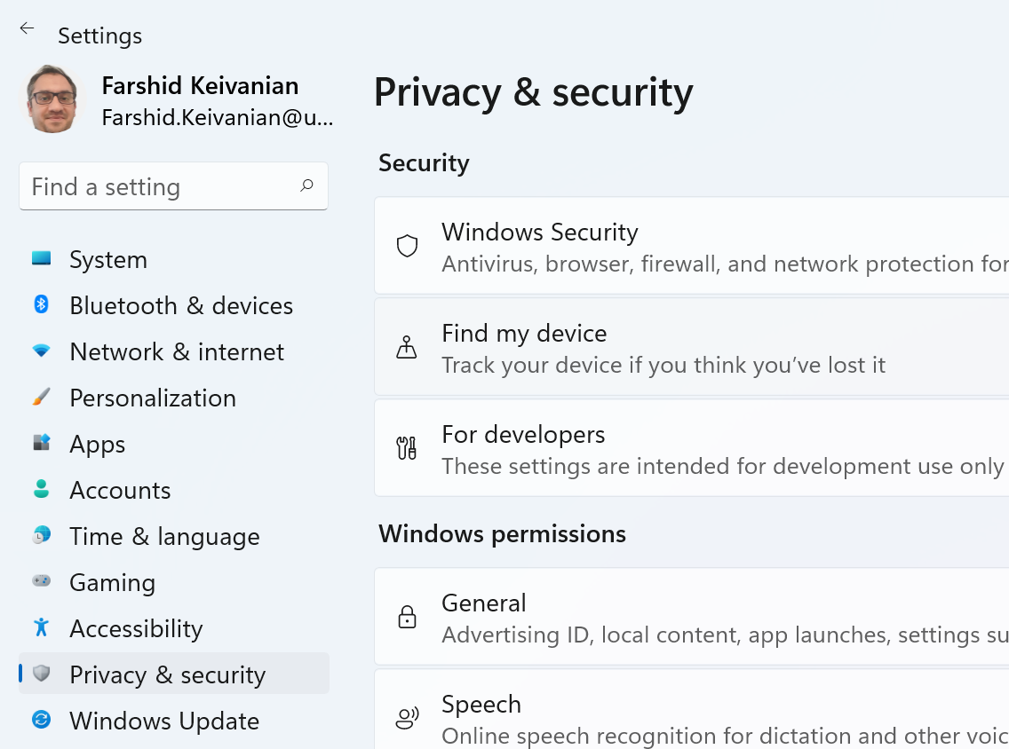
Physical Protection
Open Settings → Press Windows Key + I.
Go to Privacy & Security.
Click Find My Device.

Slide 44
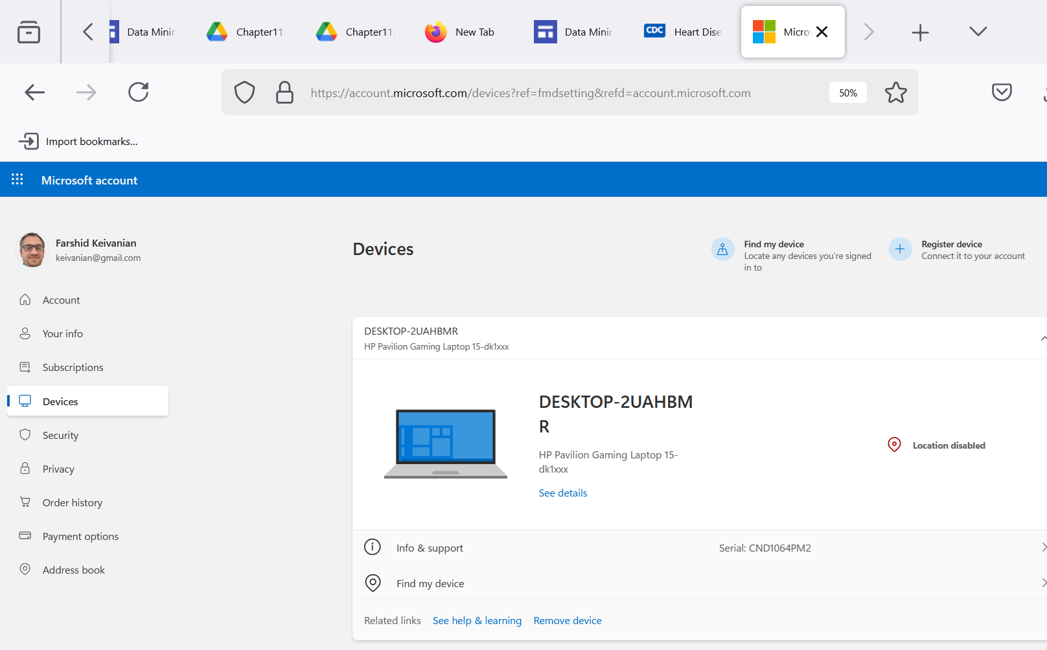
Physical Protection
Turn Find My Device to ON.
Make sure your Microsoft account is signed in.
Now, if your laptop is lost, you can go to the Microsoft Find My Device website and locate it on a map.

Slide 45
Physical Protection
Note:
Laptop must be connected to the Internet.
It doesn't use GPS exactly; it uses Wi-Fi or network positioning.
Some premium laptops (e.g., Dell Latitude models) have built-in GPS chips for even better tracking.

Slide 46
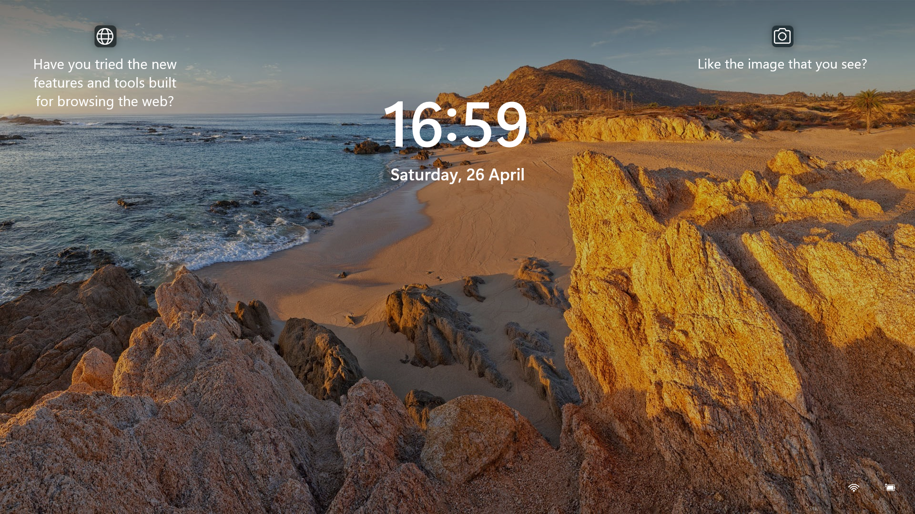
Lock Screens When Leaving
Why: If you leave your computer unlocked, anyone can access your data.
Quick Tip to Lock Instantly:
Press Windows Key + L when leaving your desk — it locks the screen immediately.
Australian workplaces and universities often have policies like "Lock It or Lose It" to prevent unauthorized access.

Slide 47
Physical Protection
Click on Find my device

Slide 48
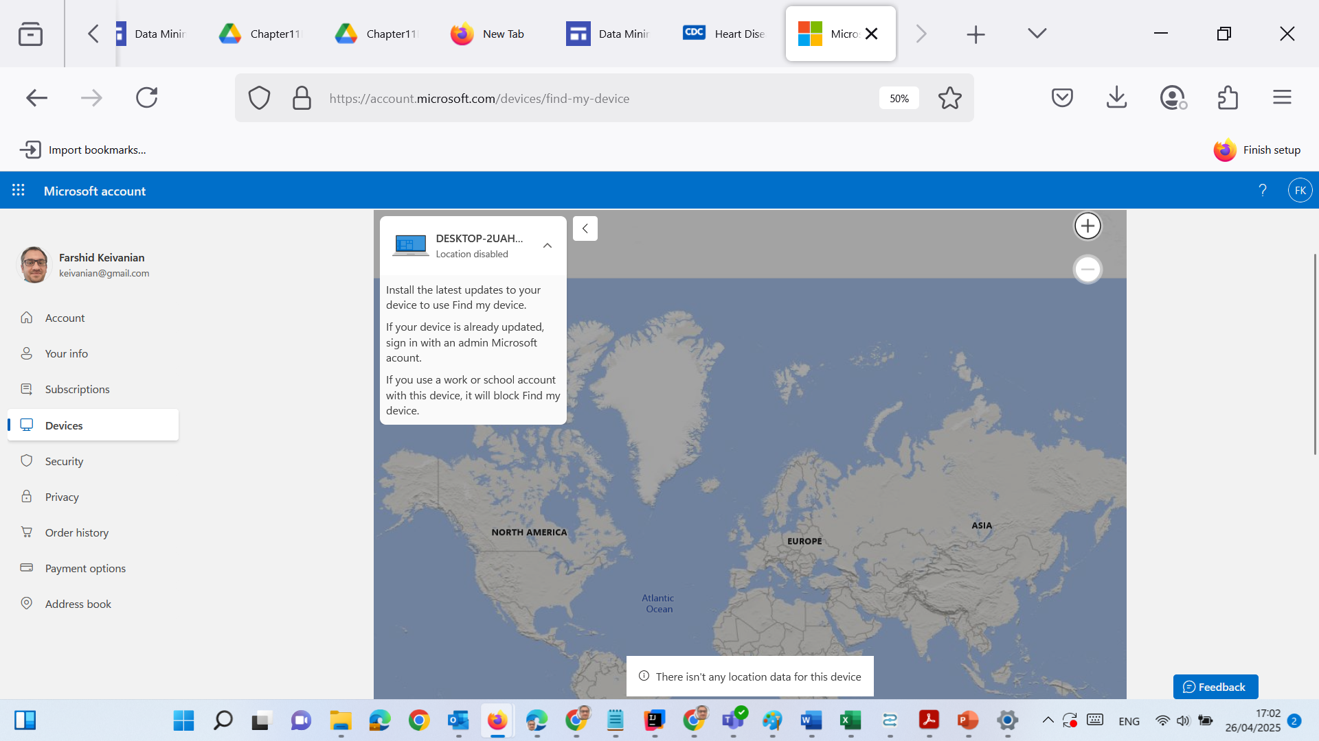
Physical Protection
Location disabled” is because the location service is turned off

Slide 49
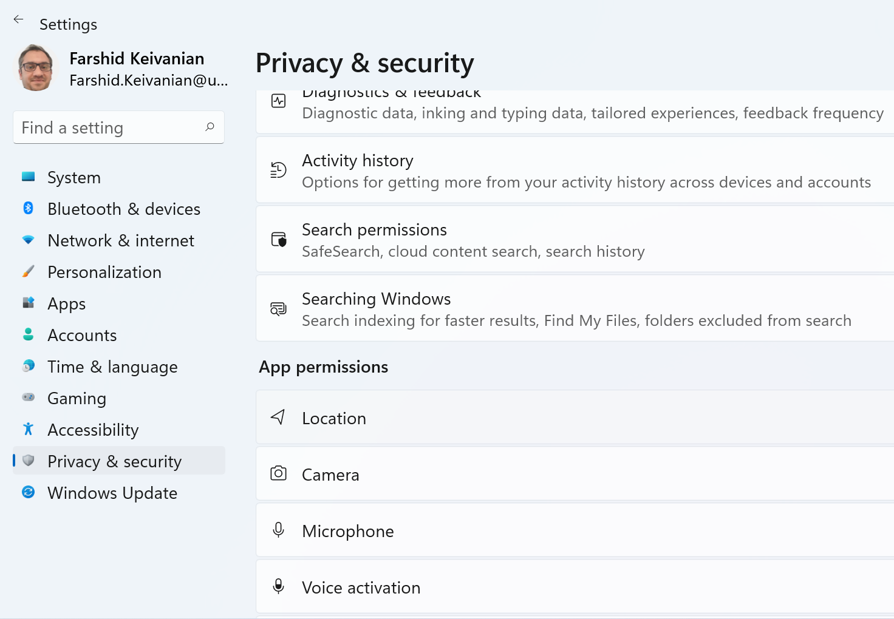
Physical Protection
1. Enable Location Services
Click Start → Open Settings ⚙️
Go to Privacy & Security > Location
Turn ON the Location Services
Scroll down and make sure “Let apps access your location” is also ON

Slide 50
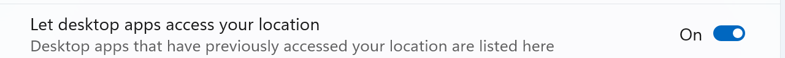
Physical Protection
1. Enable Location Services
Click Start → Open Settings ⚙️
Go to Privacy & Security > Location
Turn ON the Location Services
Scroll down and make sure “Let apps access your location” is also ON

Slide 51
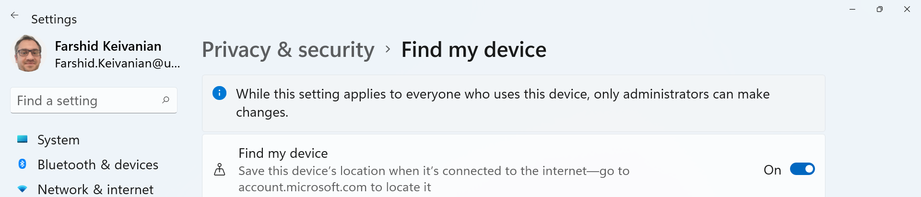
Physical Protection
2. Enable “Find My Device”
Still in Settings > Go to Privacy & Security
Click Find my device
Toggle Find my device = ON
It will ask you to sign into your Microsoft account (if not already)

Slide 52
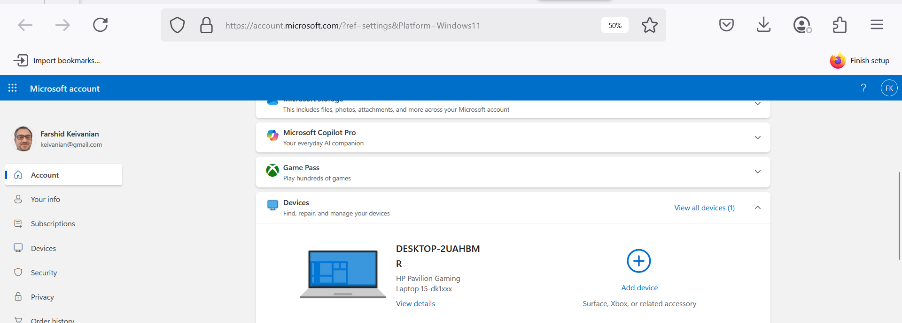
Physical Protection
You can also add Xbox, Surface

Slide 53
Secure Remote Access & Admin Controls
1. SSH vs. Telnet (Analogy Time!)
Telnet is like shouting secrets in a public café — anyone nearby can hear.
SSH is like whispering inside a soundproof room — it's encrypted and secure. Always use SSH/SCP for remote system access — especially in workplaces or when logging into servers remotely (e.g., uni VPN or server admin).

Slide 54
Secure Remote Access & Admin Controls
2. Admin Accounts
Admins shouldn’t use their personal or generic logins to make system changes. Example: If an ACU staff member updates student results using their personal email login, it’s hard to trace accountability.

Slide 55
Secure Remote Access & Admin Controls
3. Logs & Alerts
Think of logs as CCTV for IT systems — they track who, when, and what happened. Alerts warn admins when something odd happens (like someone trying to guess passwords).

Slide 56
Secure Remote Access & Admin Controls
Role-Playing:
You’re a sysadmin. A breach occurred but no logs were kept. What happens?
Investigation is hindered; security audit fails.

Slide 57
Key Hardening Concepts
Concept | Real-World Analogy | Australian Example
OS Hardening | Locking unused doors | Disabling Telnet on campus machines
Antimalware | Hand sanitiser | Using Norton/McAfee
Patch Management | Fixing broken locks | Microsoft updates
Firewalls/HIDS | Security guards/CCTV | Firewall logs at ACU
VPNs | Secure tunnel | ACU VPN
WPA2 | Smart lock | Home Wi-Fi
Encryption | Safe box | BitLocker on work laptops
Backups | Spare keys | Google Drive/iCloud backup
Deep Freeze | Factory reset | Library PCs
SSH | Whispering vs. shouting | SSH for remote lab access

Slide 58
Host Hardening (Patch, Firewall, IDS, VPN)
Role-Play Debate: Should students be required to use VPNs off-campus?
No: It may impact the grade!

Slide 59
Securing Network Devices
Operation Centers (NOC): Think of this as the “command center” of a hospital or airport — it monitors everything happening in the network: performance, updates, and alerts. In Australian universities, NOCs ensure smooth Wi-Fi and server access 24/7.

Slide 60
Securing Network Devices
VLANs (Virtual LANs): Just like separating cars into different lanes on a freeway to avoid traffic jams, VLANs keep different devices (e.g., staff vs student networks) organised and secure within one big network.

Slide 61
Securing Network Devices
Switch/Router Security: Imagine if your front door had the same factory key as everyone else's — anyone could walk in! That’s what happens when default passwords are left unchanged on network devices. Always change default credentials.

Slide 62
Securing Network Devices
Problem-Solving Scenario
A router in the lab still uses its default password. What should you do?
Change the password right away Notify the IT department so they can log the change and secure access.

Slide 63
Voice and Video Security
VoIP & Cameras: These are communication tools that use the internet — like Skype, Zoom, or CCTV you can watch remotely. Analogy: Think of VoIP like making a call through email instead of the phone line. Cameras are like your eyes, but connected to Wi-Fi.

Slide 64
Voice and Video Security
IoT Sensors: Internet of Things (IoT) sensors can monitor temperature, motion, doors, and more. Example: Hospital fridges in Australia use IoT sensors to track vaccine storage temperatures.

Slide 65
Voice and Video Security
Class Discussion Prompt
Q: What security risks do IoT devices bring?
They’re often:
left unpatched (not updated),
have default usernames/passwords (e.g., admin/admin),
and use weak encryption — like whispering secrets through a paper cup phone.

Slide 66
Physical Security Controls
Fences/Biometrics Think of fences like the boundary walls of a school — they keep out strangers. Biometrics (like fingerprint or face scan) are like your student ID card, but built into your body — they prove exactly who you are.

Slide 67
Physical Security Controls
Access Logs This is like the visitor sign-in sheet at a university front desk. It records exactly who entered a building and when — useful if something suspicious happens.

Slide 68
Physical Security Controls
Debate Prompt
Should biometrics be mandatory at data centers? Yes = High security, hard to fake No = Privacy concerns, and what if the scanner fails?

Slide 69
Surveillance and Intrusion
Guards & Escorts Think of guards like the security officers at shopping malls — they step in when technology can’t. Escorts guide visitors and stop them from wandering into restricted areas.

Slide 70
Surveillance and Intrusion
Video Surveillance This is like having dashcams in cars — they don’t stop incidents, but they help us see what happened and who was involved. Cameras help catch intruders after or even during suspicious activity.

Slide 71
Surveillance and Intrusion
RFID Surveillance Imagine putting a tracking tag on your suitcase at an airport. RFID tags on assets (like laptops or projectors) help staff know where important gear is, and if it goes missing.

Slide 72
Fire Safety – Why It Matters in IT
Fire = Major Threat Just like you wouldn’t leave a candle burning unattended at home, you can’t ignore fire risks in data centers. One spark can destroy all servers, data, and business operations.
Prevention and Detection are a Must Think of smoke detectors and suppression systems as smoke alarms for your digital brain — they give early warning so you don’t lose years of work and systems in minutes.

Slide 73
Fire Safety – Why It Matters in IT
Real Example:
At ACU data centers, they use fire suppression systems (like sprinklers and gas systems) to stop fires before they spread to devices.

Slide 74
Fire Safety – Why It Matters in IT
Problem Scenario:
If a server room has no smoke detector, what do you do?
Solution: Install detectors ASAP and do a full fire safety review (include wiring checks, equipment spacing, and backup plans).

Slide 75
Fire Safety – Why It Matters in IT
Fire doesn’t steal data — but it destroys it. Cybersecurity isn't just about hackers — it’s about protecting systems from any threat, including physical ones like fire.

Slide 76
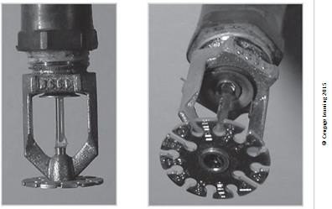
Water Sprinkler System
Sprinkler systems automatically release water when the room gets too hot (around 60-65°C). It's like a safety valve that opens when it senses fire.
Example (Australia): Found in most university labs and shopping centres like Westfield Sydney.

Slide 77
Water Sprinkler System
Role-Playing Debate: Should data centres avoid water-based sprinklers?
Answer Example: Water is effective but could damage IT hardware. Gas systems may be better in such environments.

Slide 78
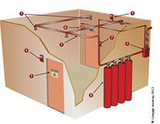
Gaseous Fire Suppression System
This system uses gas instead of water to put out fires without damaging electronic equipment.
Real-World Analogy: Like blowing out a candle without getting wax on the table.

Slide 79
Gaseous Fire Suppression System
Activity Ideas:
Discussion: Which industries benefit most from gas suppression?
Debate: CO2 vs FM-200 gas systems.
Answer Example: Data centres use FM-200 as it's non-conductive and safe for electronics.

Slide 80
Water Problems
Too much or too little water can harm equipment. Water sensors help prevent flooding or dry system failure.
Example (Australia): Major office buildings use floor-level water detectors near server racks.
Activity Ideas:
Discussion: What happens if water pipes leak near backup systems?

Slide 81
Structural Collapse
Buildings must not be overloaded or poorly maintained. Regular checks by engineers are critical.
Analogy: Like a bridge that can only hold a certain number of cars.
Activity Ideas:
Debate: Should all IT buildings require annual structural audits?
Research: Identify causes of collapses in Australian commercial buildings.

Slide 82
Maintenance of Facility Systems
Security systems need regular testing and documentation to stay reliable.
Analogy: Like servicing your car to keep it running smoothly.
Activity Ideas:
Discussion: What happens if a security system isn’t tested monthly?

Slide 83
Interception of Data
Hackers can spy by watching screens, listening to signals, or tapping into data lines.
Analogy: Like eavesdropping on a phone call.
Activity Ideas:
Research: What is TEMPEST and is it used in Australia?
Debate: Should we shield all computer rooms from EMR?

Slide 84
Securing Mobile and Portable Systems
Laptops and phones need stronger security because they leave the building and can get lost.
Example: Australian unis often use CompuTrace or Prey Project to track stolen devices.
Activity Ideas:
Problem Solving: How would you secure 100 student laptops?
Debate: Is remote wipe ethical if it deletes personal files?

Slide 85
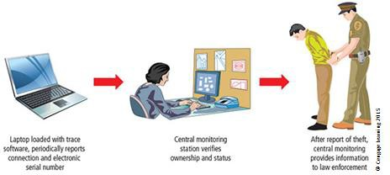
Laptop Recovery Process
Tracking software reports stolen laptop locations to a monitoring centre, helping police find them.
Activity Ideas:
Discussion: What privacy risks come with this tracking?

Slide 86
Remote Computing Security
Remote computing means working on a computer system from somewhere outside the company’s main office—like from home, a café, airport, or satellite office.
Telecommuting is when employees use the internet or a private connection (like VPN) to work from remote locations.

Slide 87
Remote Computing Security
These systems are more vulnerable because they connect from outside—kind of like leaving your house door open while on a video call.
Therefore, remote devices must be even more secure than office systems. Think antivirus, VPNs, and regular software updates.

Slide 88
Remote Computing Security
Real-world Analogy:
Imagine your home is your company’s office. If you start working at a café, it’s like taking your valuables outside. So you need to be extra careful—not just lock your bag, but also keep an eye on who’s watching you or trying to snatch it. That’s how remote security works.

Slide 89
Remote Computing Security
🇦🇺 Australian Example:
During COVID-19, many Aussie public servants in Canberra and Melbourne started working remotely. Government agencies enforced VPN use and endpoint protection tools like CrowdStrike or Sophos on all remote laptops.

Slide 90
Remote Computing Security
Problem-Solving Scenario:
Case: Sarah, an HR officer in Melbourne, logs in from a public Wi-Fi hotspot. Her laptop isn’t using a VPN. Question: Identify three security risks in this situation and suggest fixes.

Slide 91
Remote Computing Security
Public Wi-Fi – easy for hackers to intercept. → Use VPN.
No endpoint protection – malware risk. → Install antivirus.
No multi-factor login – easier access. → Use MFA like SMS or authenticator apps.

Slide 92
Summary
This chapter discussed the technologies, processes and procedures that cybersecurity specialists use to defend the systems, devices, and data that make up the network infrastructure.
Host hardening includes securing the operating system, implementing an antivirus solution, and using host-based solutions such as firewalls and intrusion detection systems.
Server hardening includes managing remote access, securing privileged accounts, and monitoring services.
Data protection includes file access control and implementing security measures to ensure the confidentiality, integrity, and availability of data.
Device hardening also involves implementing proven methods of physically securing network devices. Protecting a cybersecurity domain is an on-going process to secure an organization’s network infrastructure and requires a constant vigilance against threats.

Slide 93

Next Week
We will study
Becoming a CS Specialist

Slide 94

Questions?

